Slide 1
Python API
Tanya Sattaya-aphitan, Ph.D.
Oct 6-7, 2020 @การยางแห่งประเทศไทย

Slide 2
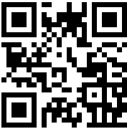
Slide URL : https://tinyurl.com/RAOT-API

Slide 3




A little bit about me !
Education
Doctor of Engineering (Software System Engineering, KMUTNB)
Research works at RWTH University Aachen, Germany
Professional Certificates
Data Engineering Professional Certification (RapidMiner)
Machine Learning Professional Certification (RapidMiner)
Applications & Use Cases Professional Certification (RapidMiner)
Sun Certified Java Programmer (SCJP)
Work Experiences
Database : Oracle, MySQL, Postgres, Elasticsearch
Backend Developer: Java, Python, PHP, NodeJS
Frontend Dev. : Vue.js
Data Visualization : Tableau
Smart Solutions : Video Analytics, IoTs, Connectivity (LoRaWan/NB-IoT) , AI/ML

Slide 4




Prof. Dr. Horst Lichter, RWTH Aachen, Germany
Babysitter
Marathoner
Switzerland

Slide 5
Agenda
Day 1
Overview & Installation
Basic Python
Call API :
BOT: Exchange Rate
AI : AI for Thai
Day 2
Working with Database : MySQL
Create Your First API
Create API with Django framework

Slide 6
API Overview

Slide 7
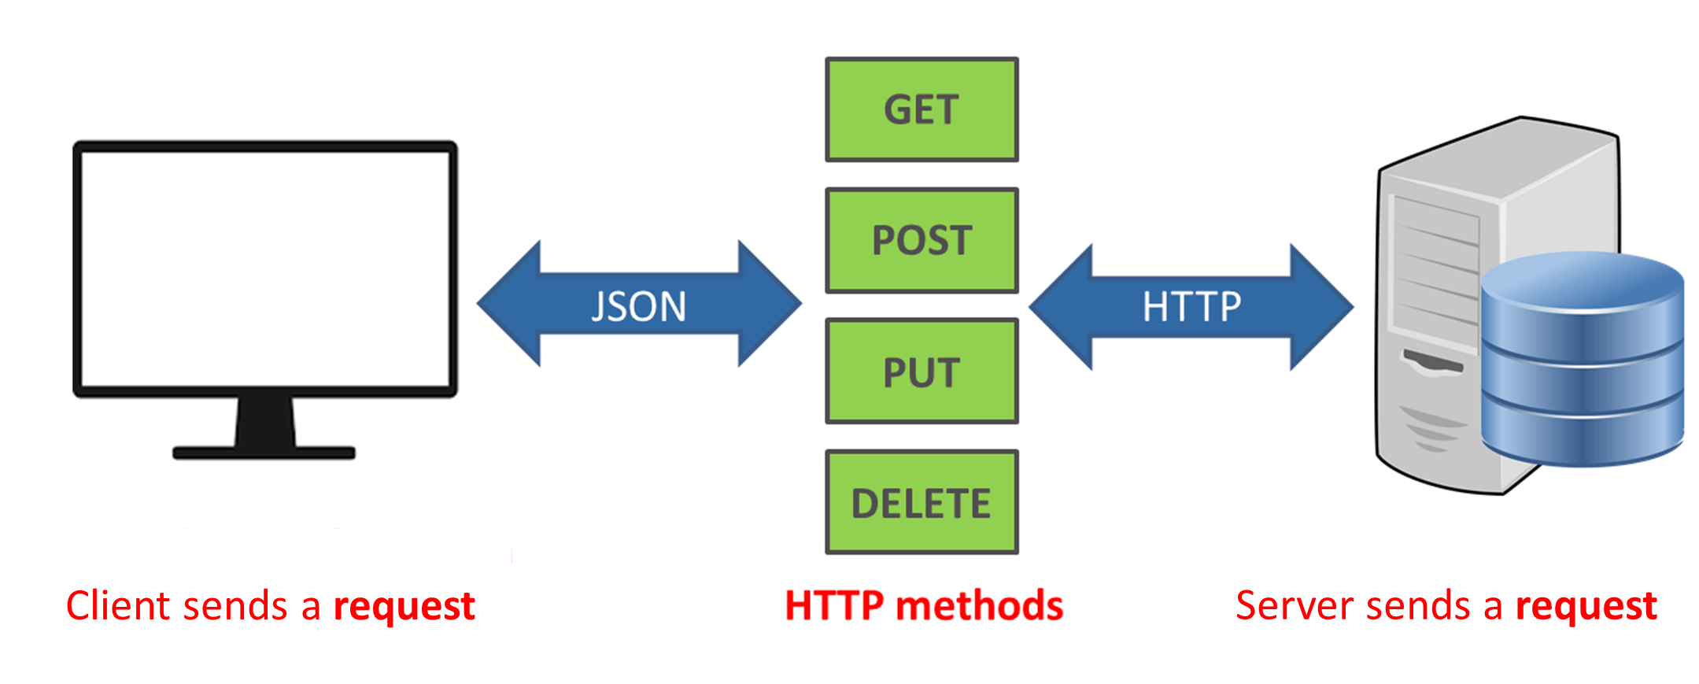
API = Application Program Interface
Img src: https://www.dailytech.in.th/api-%E0%B8%84%E0%B8%B7%E0%B8%AD%E0%B8%AD%E0%B8%B0%E0%B9%84%E0%B8%A3/

Slide 8
API vs Web Service
API = Application Program Interface
Web Service = API (operate over HTTP)
All Web Services = API
In this course !
API = Web Service
API
Web Service
(HTTP)
cobra
com
proprietary

Slide 9
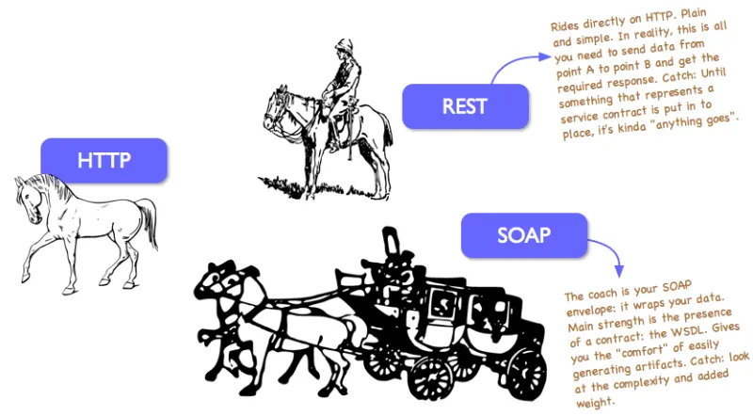
SOAP & REST
SOAP (Simple Object Access Protocol) - Standard
REST (REpresentational State Transfer) - Data
More Information https://rapidapi.com/blog/types-of-apis/

Slide 10
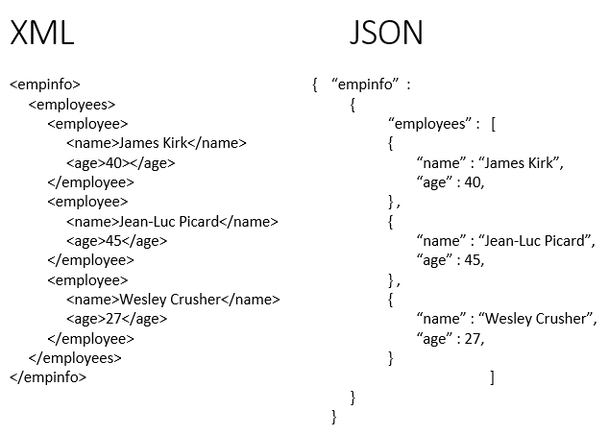
SOAP REST

Slide 11
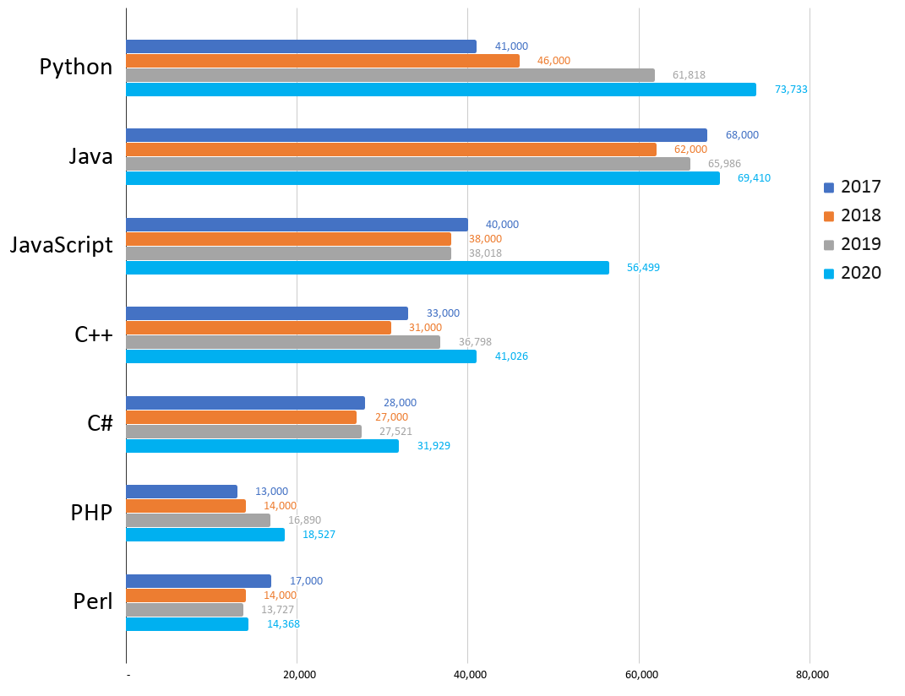
Programming Language
Image Source https://www.codingdojo.com/blog/top-7-programming-languages-of-2020

Slide 12
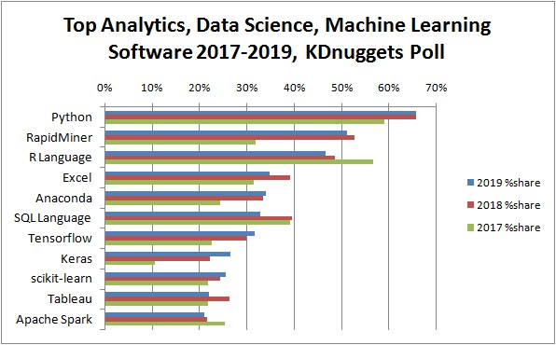
Data Science Language (Machine Learning / AI)

Slide 13
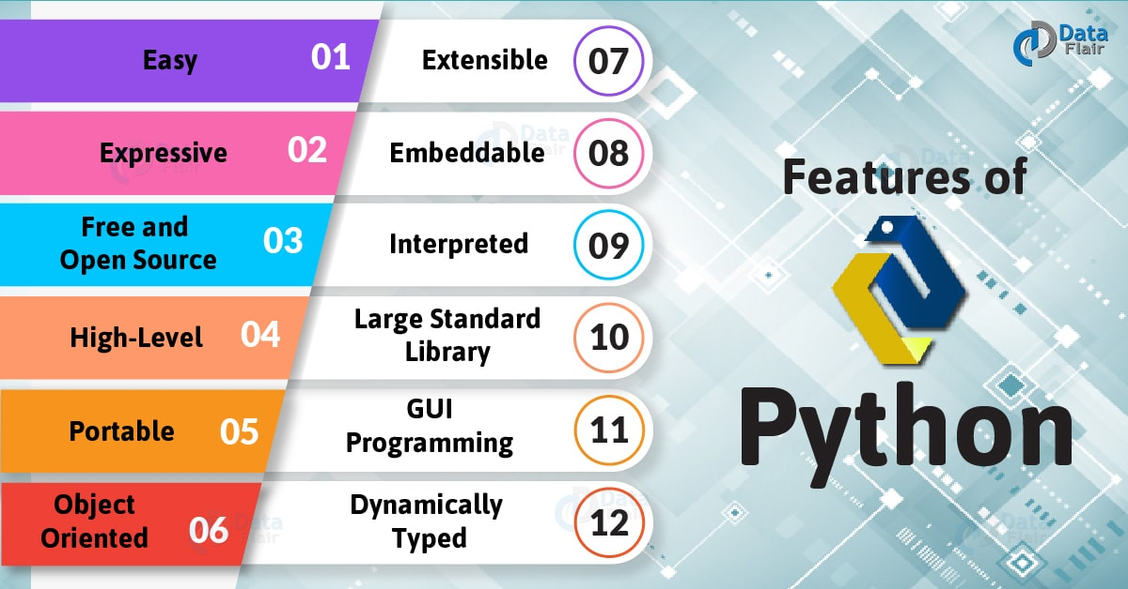
https://data-flair.training/blogs/features-of-python/

Slide 14
Installation

Slide 15
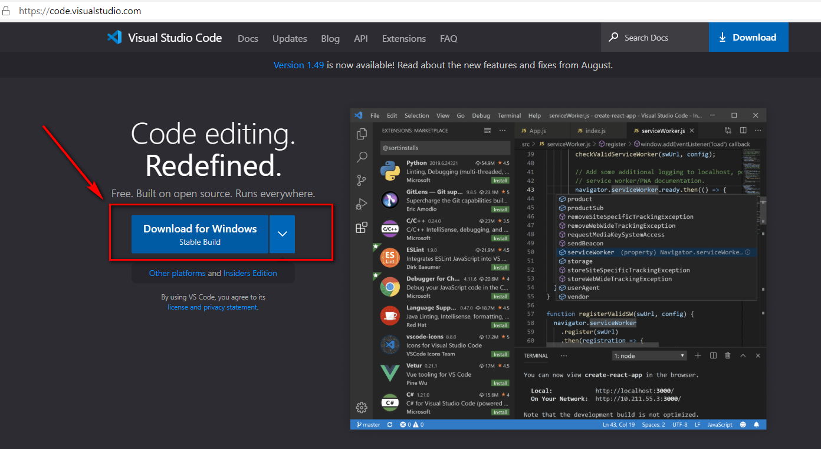
IDE: Visual Studio Code

Slide 16
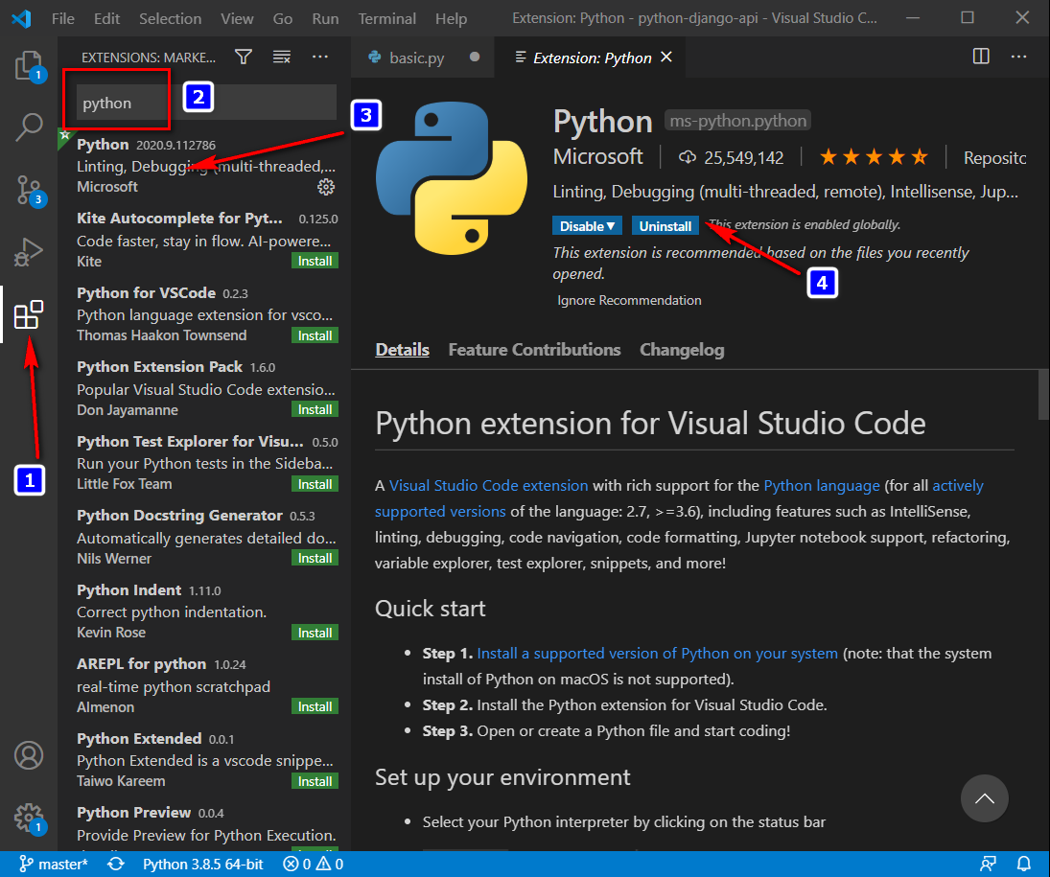
IDE : Plugin python

Slide 17
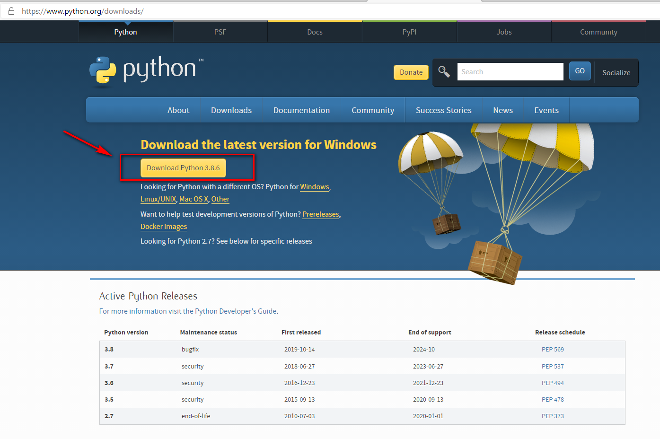
Python
python --version
Python 3.8.6

Slide 18
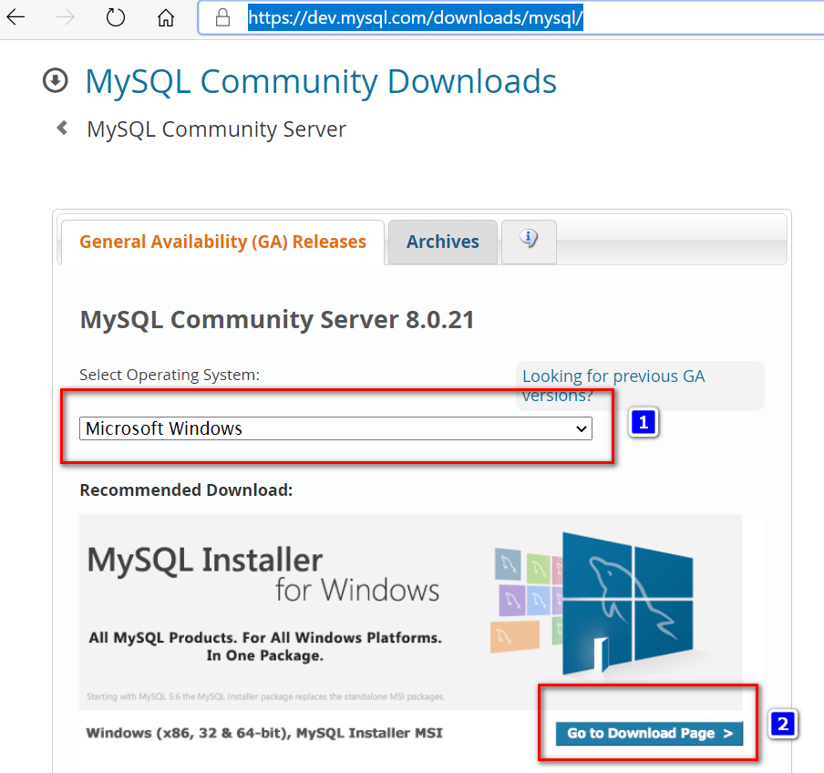
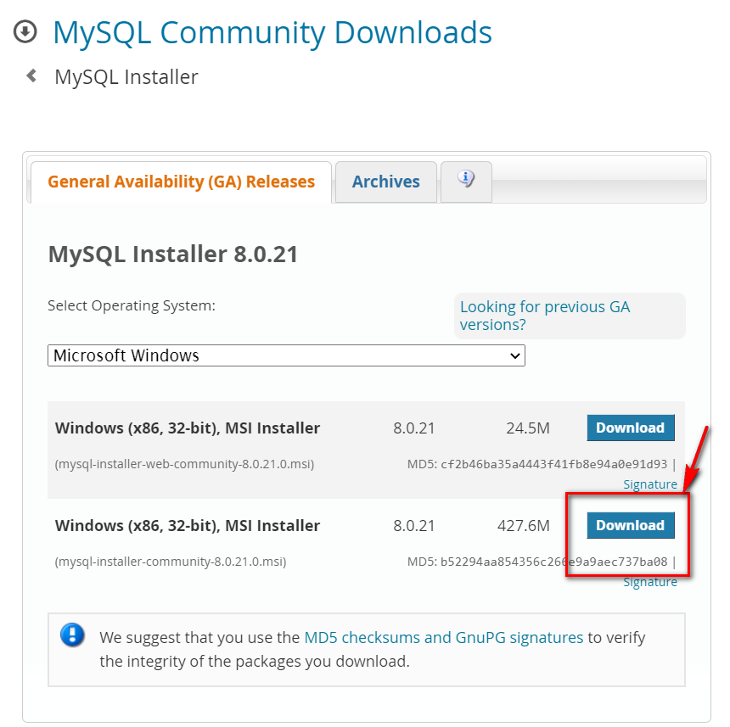
Database : MySQL Community Server
https://dev.mysql.com/downloads/mysql/

Slide 19
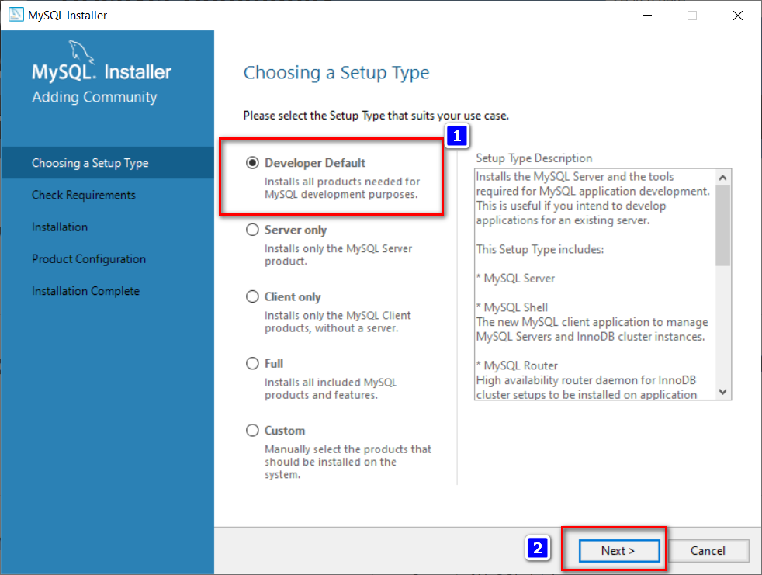
Install : developer -> next -> next

Slide 20
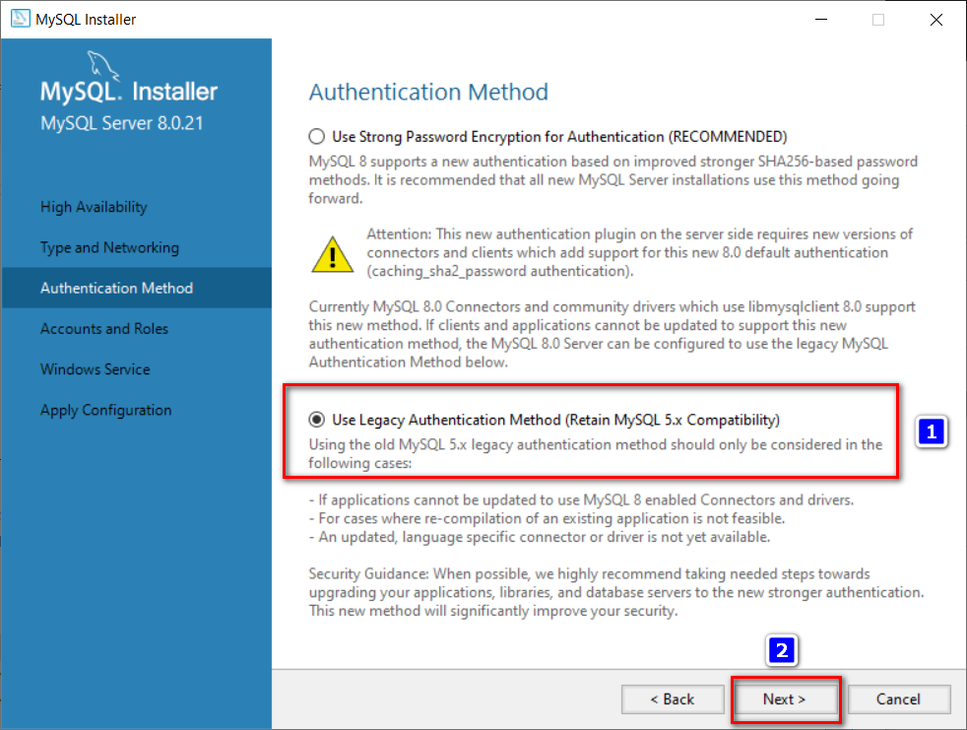
Use Legacy

Slide 21
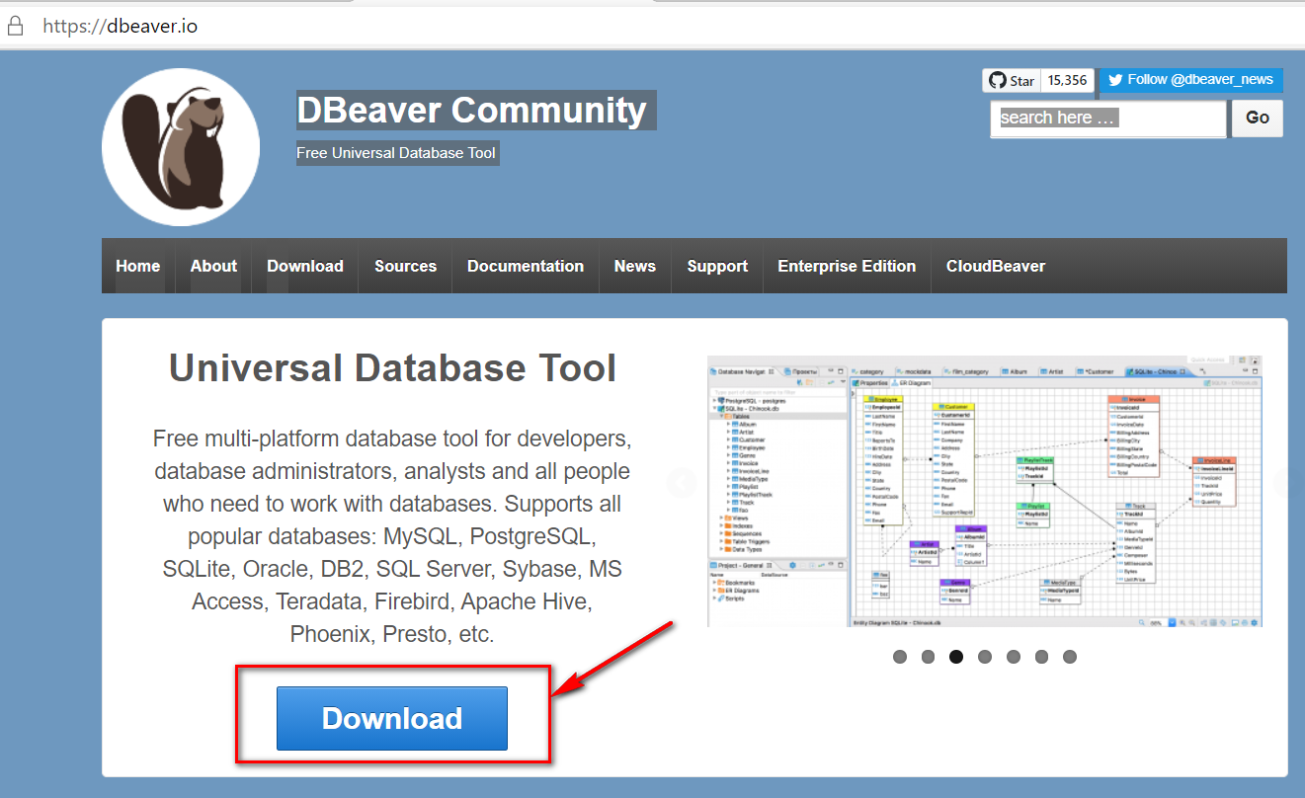
DB GUI : DBeaver Community

Slide 22
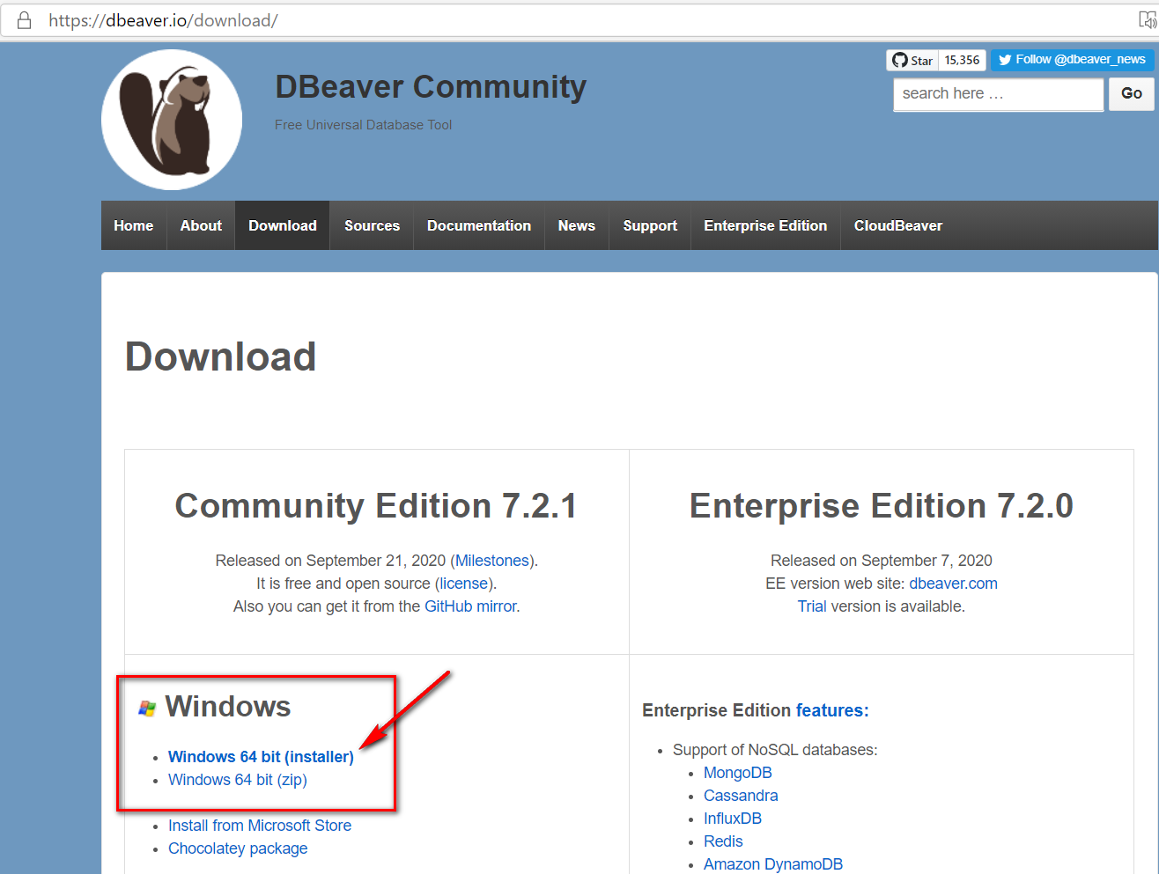
Download & Install

Slide 23
Basic Python

Slide 24
Data Types

Slide 25
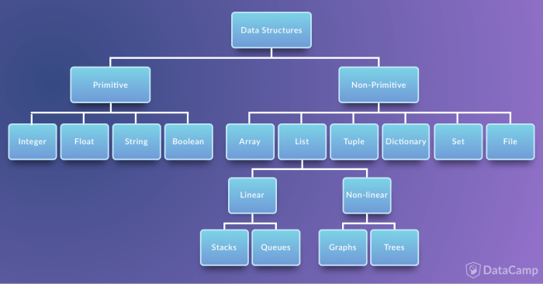
Python Variables
Source: datacamp.com

Slide 26
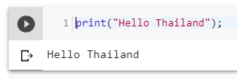
Print
Hello.py
print("Hello Thailand");
python Hello.py

Slide 27
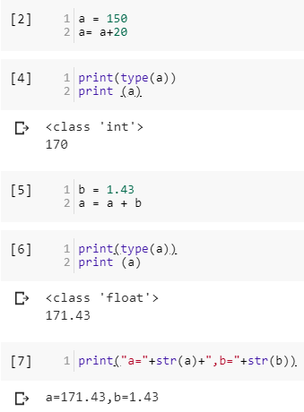
Primitive type
a = 150
a= a+20
print(type(a))
print (a)
b = 1.43
a = a + b
print(type(a))
print (a)
print("a="+str(a)+",b="+str(b))

Slide 28
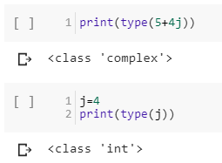
Complex Type
print(type(5+4j))
j=4
print(type(j))

Slide 29
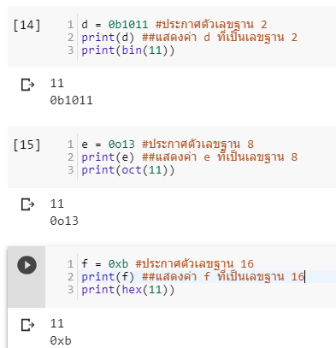
Complex : Binary Octal Hexa
d = 0b1011 #ประกาศตัวเลขฐาน 2
print(d) ##แสดงค่า d ที่เป็นเลขฐาน 2
print(bin(11))
e = 0o13 #ประกาศตัวเลขฐาน 8
print(e) ##แสดงค่า e ที่เป็นเลขฐาน 8
print(oct(11))
f = 0xb #ประกาศตัวเลขฐาน 16
print(f) ##แสดงค่า f ที่เป็นเลขฐาน 16
print(hex(11))

Slide 30
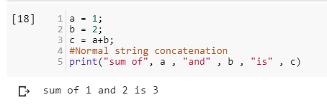
Concat String with Int
a = 1;
b = 2;
c = a+b;
#Normal string concatenation
print("sum of", a , "and" , b , "is" , c)

Slide 31
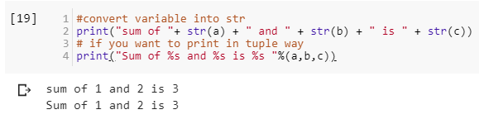
Concat String with Int (cont)
#convert variable into str
print("sum of "+ str(a) + " and " + str(b) + " is " + str(c))
# if you want to print in tuple way
print("Sum of %s and %s is %s "%(a,b,c))
print("Sum of {0} and {1} is {2} ".format(a,b,c))

Slide 32
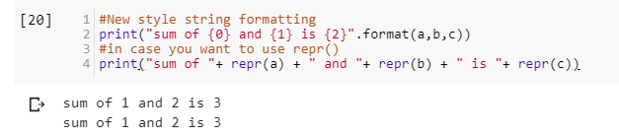
Concat String with Int (cont)
#New style string formatting
print("sum of {0} and {1} is {2}".format(a,b,c))
#in case you want to use repr()
print("sum of "+ repr(a) + " and "+ repr(b) + " is "+ repr(c))

Slide 33
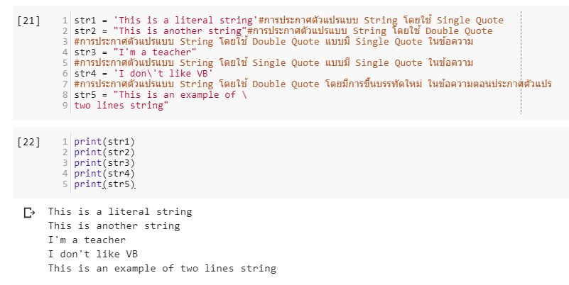
String
str1 = 'This is a literal string'#การประกาศตัวแปรแบบ String โดยใช้ Single Quote
str2 = "This is another string"#การประกาศตัวแปรแบบ String โดยใช้ Double Quote
#การประกาศตัวแปรแบบ String โดยใช้ Double Quote แบบมี Single Quote ในข้อความ
str3 = "I'm a teacher"
#การประกาศตัวแปรแบบ String โดยใช้ Single Quote แบบมี Single Quote ในข้อความ
str4 = 'I don\'t like VB'
#การประกาศตัวแปรแบบ String โดยใช้ Double Quote โดยมีการขึ้นบรรทัดใหม่ ในข้อความตอนประกาศตัวแปร
str5 = "This is an example of \
two lines string"

Slide 34
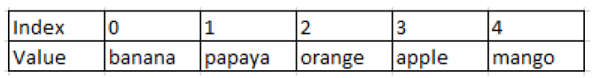
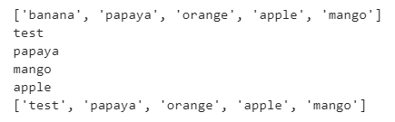
List (Array)
fruits = ["banana","papaya",
"orange","apple","mango"]
print(fruits)
fruits[0] = "test"
print(fruits[0])
print(fruits[1])
print(fruits[-1])
print(fruits[-2])
print(fruits)
#add data to List
fruits.append('pen')
print(fruits)

Slide 35
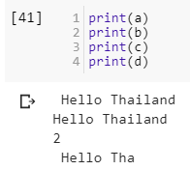
Functions
a = " Hello Thailand "
b = a.strip() #ตัด White Space
c = a.count('a') #นับว่ามี a กี่ตัวใน 1 คำ
#slicing index เริ่มที่ 0
e = a[0:10] #เป็นการ slice ตั้งแต่ 0-9 แต่ไม่รวม 10 (exclusion)

Slide 36
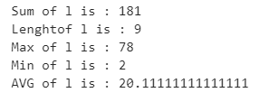
Statistic Functions
!pip install statistics
import statistics
l = [15, 18, 2, 36, 12, 78, 5, 6, 9]
print("Sum of l is : "+ str(sum(l)))
print("Length of l is : "+ str(len(l)))
print("Max of l is : "+ str(max(l)))
print("Min of l is : "+ str(min(l)))
print("AVG of l is : "+ str(sum(l) / float(len(l))))

Slide 37
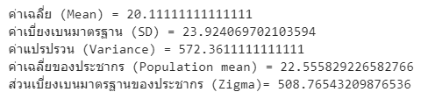
Statistic Functions
print("ค่าเฉลี่ย (Mean) = "+ str(statistics.mean(l)))
print("ค่าเบี่ยงเบนมาตรฐาน (SD) = "+ str(statistics.stdev(l)))
print("ค่าแปรปรวน (Variance) = "+ str(statistics.variance(l)))
print("ค่าเฉลี่ยของประชากร (Population mean) = "+ str(statistics.pstdev(l)))
print("ส่วนเบี่ยงเบนมาตรฐานของประชากร (Zigma)= "+ str(statistics.pvariance(l)))

Slide 38
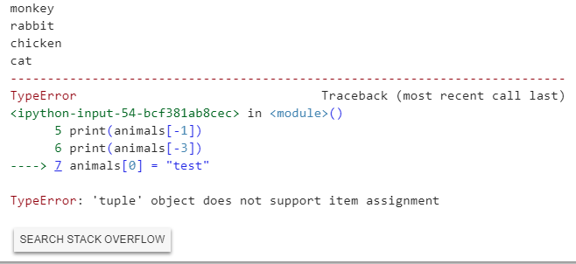
Tuple -- data cannot be changed
animals = ("monkey","rabbit", "cat", "kangaroo","chicken")
print(animals[0])
print(animals[1])
print(animals[-1])
print(animals[-3])
animals[0] = "test" #cannot change

Slide 39
Dictionary
data = {
'day':['1/1/2018','2/1/2018','3/1/2018'],
'temp':[20,10,15],
'event':['cold','cold','cold']
} #สร้างข้อมูล
print(data['day'])
#เพิ่มข้อมูล
data['x']=[1,2,3]
print(data)

Slide 40
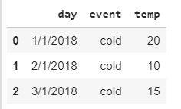
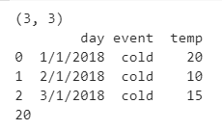
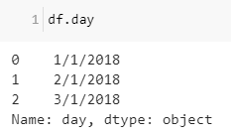
Data Frame
import pandas as pd #Import pandas
data = {
'day':['1/1/2018','2/1/2018','3/1/2018'],
'temp':[20,10,15],
'event':['cold','cold','cold']
} #สร้างข้อมูล
df= pd.DataFrame(data)
print(df.shape) #ดูขนาดข้อมูล
print(df) #แสดงข้อมูลที่อยู่ใน DataFrame
print(df['temp'].max())
df.day
df['day']

Slide 41
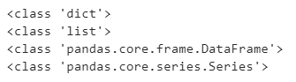
Data Frame
print(type(data))
print(type(data['temp']))
print(type(df))
print(type(df.temp))

Slide 42
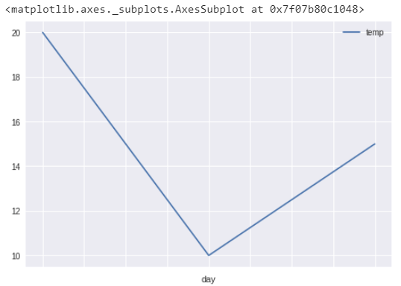
Plot graph (change index)
df.set_index('day',inplace=True)
df.sort_index()
df.plot()

Slide 43
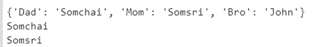
Dictionary
name={'Dad':'Somchai','Mom':'Somsri','Bro':'John'} #สร้างข้อมูลเก็บไว้ใน Dictionary
print(name) #แสดงข้อมูลเก็บไว้ใน Dictionary ที่มีชื่อว่า name
print(name['Dad']) #แสดงข้อมูลเก็บไว้ใน Dictionary ที่มีชื่อว่า name โดยมี Key คือ Dad
print(name['Mom']) #แสดงข้อมูลเก็บไว้ใน Dictionary ที่มีชื่อว่า name โดยมี Key คือ Mom

Slide 44
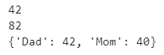
Dictionary
#ทาเช่นเดิม แต่เก็บค่าในรูปแบบ Int
age={'Dad':42,'Mom':40}
print(age['Dad'])
print(age['Dad']+ age['Mom']) #คานวณค่าที่ได้จากการเรียกข้อมูลโดยใช้ Key
print(age)

Slide 45
NumPy
import numpy as np #import numpy
a = np.array([1,2,3,4,5,6]) #สร้างข้อมูล
print(a[4]) #แสดงผลค่าที่อยู่ในตัวแปร a โดยมี index อยู่ที่ 5
print(a[3]+a[4]) #แสดงผลค่าผลบวกที่ index 3 และ 4 ในตัวแปร a

Slide 46
Control Flow

Slide 47
Control Flow
Comparison Operators
==มีค่าเท่ากับ
!=มีค่าไม่เท่ากับ
>มีค่ามากกว่า
>=มีค่ามากกว่าหรือเท่ากับ
<มีค่าน้อยกว่า
<=มีค่าน้อยกว่าหรือเท่ากับ
Indent สำคัญใน Python

Slide 48
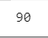
If-Else
a = 10
b = 30
c = 90
#indent
if(a == b):
print(a)
elif(a > b):
print(a)
elif(a < b):
print(c)

Slide 49
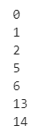
Loop
for x in range(3):
print(x)
for x in range(5, 7):
print(x)
for x in range(10, 15):
if(x > 12):
print(x)

Slide 50
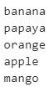
Loop over List
fruits = ["banana","papaya","orange","apple","mango"]
for fruit in fruits:
print(fruit)

Slide 51
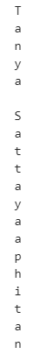
Loop over String
name = "Tanya Sattayaaphitan"
for char in name:
print(char)

Slide 52
Data Type Handling and Conversion
int(x [,base]) แปลง object x ให้เป็น integer
long (x [,base]) แปลง object x ให้เป็น long
float (X) แปลง object x ให้เป็น float
complex (real [,imag]) ทาให้เป็นตัวเลข complex
str(x) แปลง object x ให้เป็น string
repr(x) แปลง object x ให้เป็น expression string
eval(str) หาค่า string เป็น object
set (seq) แปลง sequence ให้เป็น set
frozenset(seq) แปลง sequence ให้เป็น frozenset
chr(x) แปลง integer ให้เป็น character
unichr(x) แปลง integer ให้เป็น Unicode character
ord(x) แปลง character (ตัวเดียว) ให้เป็น integer
hex (x) แปลง integer ให้เป็น hexadecimal string
oct(x) แปลง integer ให้เป็น octal string

Slide 53
Function
def plus(a,b):
c = a + b
return c
print(plus(1,2))

Slide 54
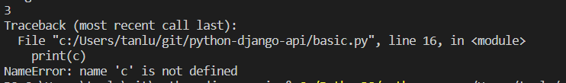
Local Variable
def plus(a,b):
c = a + b
return c
print(plus(1,2))
print(c)

Slide 55
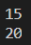
Local Variable
age = 20
def plus10(a):
age = a + 10
return age
print(plus10(5))
print(age)

Slide 56
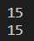
Global Variable
age = 20
def plus10(a):
global age
age = a + 10
return age
print(plus10(5))
print(age)

Slide 57

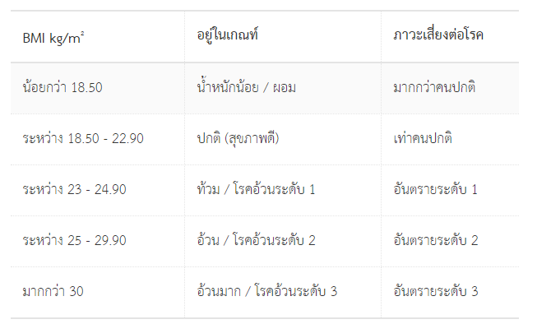
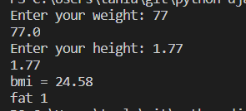
Python Lab : Write a BMI program (bmi.py)
Input weight as “kg”
Input height as “m”
177 cm = 1.77 m
Hint for Input
height = input("Enter your height: ")
height = float(height)

Slide 58
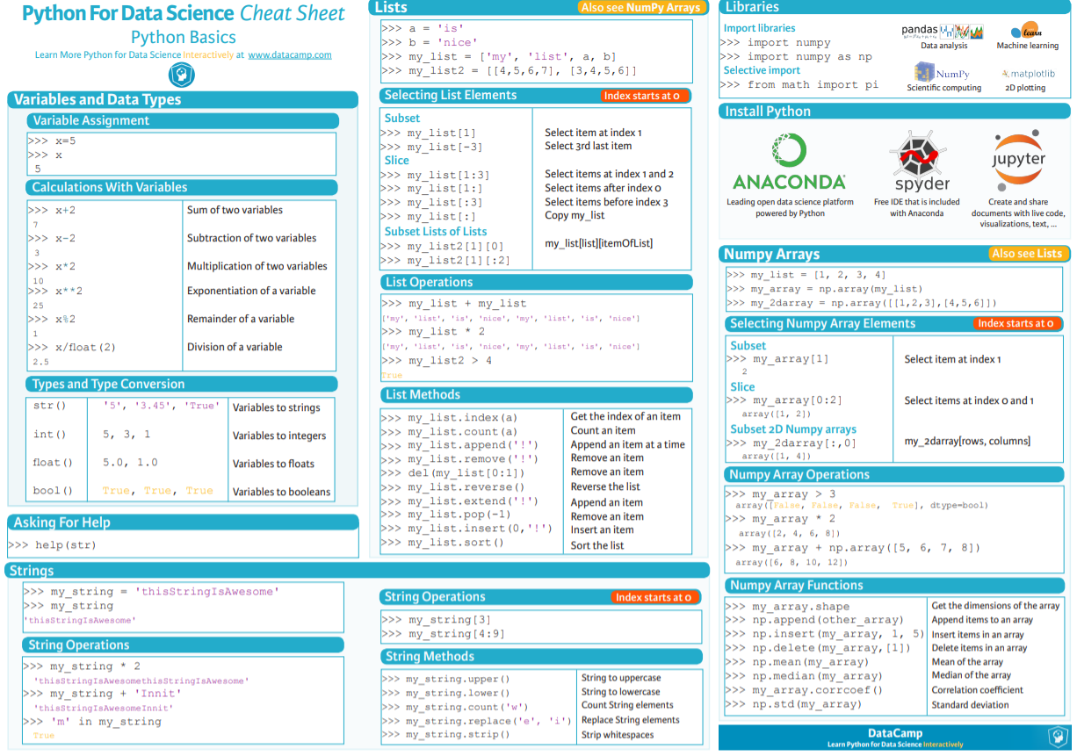
Python cheat sheet
https://s3.amazonaws.com/assets.datacamp.com/blog_assets/PythonForDataScience.pdf

Slide 59
Call BOT API

Slide 60
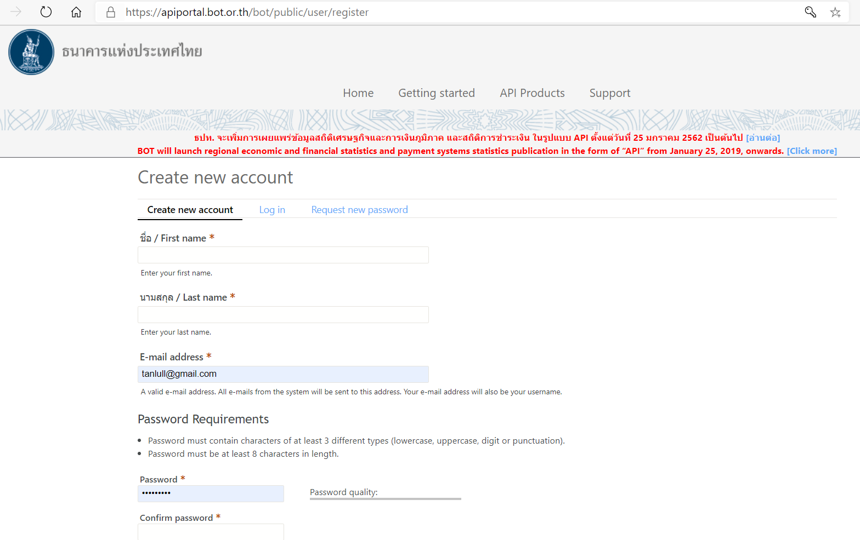
BOT API
https://apiportal.bot.or.th/bot/public/user/register

Slide 61
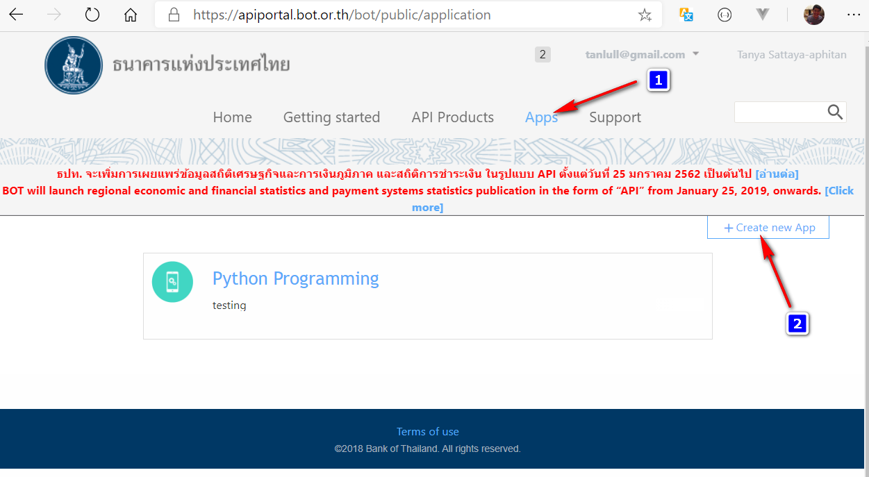
Register API

Slide 62

Register Application : Python API

Slide 63

Copy Client ID to field in the next step : 1edd90f8-f587-4e21-9433-81db0f322825

Slide 64

Activate API

Slide 65

Activate API

Slide 66

Browse API

Slide 67

Code Example
Client ID from previous step : 1edd90f8-f587-4e21-9433-81db0f322825

Slide 68
Request API -- BOT_API_Daily.py
import http.client
conn = http.client.HTTPSConnection("apigw1.bot.or.th")
headers = {
'x-ibm-client-id': "1edd90f8-f587-4e21-9433-81db0f322825",
'accept': "application/json"
}
conn.request("GET", "/bot/public/Stat-ReferenceRate/v2/DAILY_REF_RATE/?start_period=2018-10-01&end_period=2018-10-31", headers=headers)
res = conn.getresponse()
data = res.read()
print(data.decode("utf-8"))

Slide 69
Response JSON
{
"result":{
"timestamp":"2018-11-04 09:35:56",
"api":"Daily Weighted-average Interbank Exchange Rate - THB / USD",
"data":{
"data_header":{
"report_name_eng":"Rates of Exchange of Commercial Banks in Bangkok Metropolis (2002-present)",
"report_name_th":"อัตราแลกเปลี่ยนเฉลี่ยของธนาคารพาณิชย์ในกรุงเทพมหานคร (2545-ปัจจุบัน)",
"report_uoq_name_eng":"(Unit : Baht / 1 Unit of Foreign Currency)",
"report_uoq_name_th":"(หน่วย : บาท ต่อ 1 หน่วยเงินตราต่างประเทศ)",
"report_source_of_data":[
{
"source_of_data_eng":"Bank of Thailand",
"source_of_data_th":"ธนาคารแห่งประเทศไทย"
}
],
"report_remark":[
],
"last_updated":"2018-11-02"
},
"data_detail":[
{
"period":"2018-10-31",
"rate":"33.2660000"
},
{
"period":"2018-10-30",
"rate":"33.2700000"
},
{
"period":"2018-10-29",
"rate":"33.1360000"
},
{
"period":"2018-10-26",
"rate":"33.0290000"
},
{
"period":"2018-10-25",
"rate":"32.9230000"
},
{
"period":"2018-10-24",
"rate":"32.8110000"
},
{
"period":"2018-10-03",
"rate":"32.3380000"
},
{
"period":"2018-10-02",
"rate":"32.3380000"
},
{
"period":"2018-10-01",
"rate":"32.2530000"
}
]
}
}
}

Slide 70

Format Response to DataFrame
pip install pandas
import pandas as pd
j=pd.io.json.loads(data)
df=pd.DataFrame(j['result']['data']['data_detail'])
#แปลงให้เป็น Type DateTime
df.period= pd.to_datetime(df.period)
#แปลงให้เป็น Type Numeric
df.rate= pd.to_numeric(df.rate)
print(df)

Slide 71

Plot graph
pip install matplotlib
import matplotlib.pyplot as plt #plot graph เส้น และกาหนดขนาดของเส้น
plt.plot(df.period,df.rate, linewidth=1) #กำหนด Description แต่ละเส้นพร้อมบอกตาแหน่งที่แสดง
plt.legend(["Line 1"], loc="upper right")
plt.show()

Slide 72

Request API Lab 1
Create BOT_API_Monthly.py
Using
Retrieve data from January 2017 to September 2020
Print data
Plot Graph

Slide 73
Test with postman

Slide 74

Test with Postman
https://www.postman.com/downloads/

Slide 75

Get Endpoint

Slide 76

Extract Information
Method: GET
Endpoint: https://apigw1.bot.or.th/bot/public/Stat-ReferenceRate/v2/DAILY_REF_RATE/?start_period=REPLACE_THIS_VALUE&end_period=REPLACE_THIS_VALUE
Header: accept: application/json
x-ibm-client-id: 1edd90f8-f587-4e21-9433-81db0f322825

Slide 77

Postman

Slide 78

New Collection

Slide 79

Add Request

Slide 80

GET / URI

Slide 81


Response

Slide 82
AI 4 Thai API

Slide 83

Request API Lab 2
https://aiforthai.in.th/

Slide 84

Sentiment Analysis

Slide 85

Python Example

Slide 86

Output

Slide 87

API Lab 2
Make your own sentiment analysis
Test Sentiment with Postman
Try another API.

Slide 88
Day 2

Slide 89
Connect Database (MySQL)

Slide 90
Database : MySQL Community Server
https://dev.mysql.com/downloads/mysql/

Slide 91
Install : developer -> next -> next

Slide 92
Use Legacy

Slide 93
DB GUI : DBeaver Community

Slide 94
Download & Install

Slide 95
Install Mysql Python library
pip install mysql-connector-python

Slide 96
Prepare Database (Mysql)
Create database api;
Use api;
create table source(
id int4,
name text,
age int4,
gender text
);
insert into source values(1,'สมปอง',20,'male');
insert into source values(2,'สมชาย',22,'male');
insert into source values(3,'สมศรี',23,'female');
insert into source values(4,'สมสมร',24,'female');
commit;
select * from source

Slide 97

Result

Slide 98
Select -- select_mysql.py
import mysql.connector as mysql
try:
#Connection
conn = mysql.connect(user='root', password='toor',host='127.0.0.1',database='api')
cursor = conn.cursor()
#Select from database
sql = "select * from source"
cursor.execute(sql)
records = cursor.fetchall()
for row in records:
print ("Id = {0} , Name = {1}, Age = {2}, Gender = {3}".format(row[0],row[1],row[2],row[3]))
except (Exception, mysql.Error) as error :
print ("Error while fetching data from Mysql.", error)
finally:
#closing database connection.
if(conn):
cursor.close()
conn.close()
print("MySQL connection is closed")
Notes:
REf: https://pynative.com/python-postgresql-select-data-from-table/

Slide 99
Insert -- insert_mysql.py
import psycopg2 as pg
try:
conn = pg.connect(user="postgres",password="postgres",host="127.0.0.1",port="5432",database="postgres")
cursor = conn.cursor()
insert_sql = "insert into source values(%s,%s,%s,%s)"
data_to_insert = (5, 'สมเจตน์', 25,'male')
cursor.execute(insert_sql, data_to_insert)
conn.commit()
count = cursor.rowcount
print (count, "Record inserted successfully into source table")
except (Exception, pg.Error) as error :
if(conn):
print("Failed to insert record into source table", error)
finally:
#closing database connection.
if(conn):
cursor.close()
conn.close()
print("PostgreSQL connection is closed")
https://raw.githubusercontent.com/tanlull/Python-Postgres-Mysql/master/insert_postgres.py

Slide 100
Update -- update_mysql.py
import mysql.connector as mysql
def updateTable(id, newid):
try:
conn = mysql.connect(user='root', password='toor',
host='127.0.0.1', database='api')
cursor = conn.cursor()
sql_update = "Update source set id = %s where id = %s"""
cursor.execute(sql_update, (newid, id))
conn.commit()
count = cursor.rowcount
print(count, "Record Updated successfully ")
except (Exception, pg.Error) as error:
print("Error in update operation", error)
finally:
# closing database conn.
if (conn):
cursor.close()
conn.close()
print("PostgreSQL conn is closed")
updateTable(5, 10)

Slide 101
Delete -- delete_mysql.py
import mysql.connector as mysql
def deleteData(id):
try:
conn = mysql.connect(user='root', password='toor',
host='127.0.0.1', database='api')
cursor = conn.cursor()
# Update single record now
sql_delete_query = "Delete from source where id = %s"
cursor.execute(sql_delete_query, (id,))
conn.commit()
count = cursor.rowcount
print(count, "Record deleted successfully ")
except (Exception, pg.Error) as error:
print("Error in Delete operation", error)
finally:
# closing database conn.
if (conn):
cursor.close()
conn.close()
print("PostgreSQL conn is closed")
deleteData(10)

Slide 102
Put it all together

Slide 103
Put it on together (Part 1) -- crud_mysql.py
import mysql.connector as mysql
conn = {};
cursor = {};
def connect():
global conn,cursor
try:
conn = mysql.connect(user='root', password='toor',
host='127.0.0.1',
database='api')
cursor = conn.cursor()
cursor.execute('SET NAMES utf8;')
cursor.execute('SET CHARACTER SET utf8;')
cursor.execute('SET character_set_connection=utf8;')
return True
except (Exception, mysql.Error) as error:
print("Error ", error)
return False
def close():
global conn,cursor
if(conn):
cursor.close()
conn.close()
print("---- closed connection --")
def selectAll():
global conn,cursor
try:
sql = "select * from source"
cursor.execute(sql)
records = cursor.fetchall()
for row in records:
print ("Id = {0} , Name = {1}, Age = {2}, Gender = {3}".format(row[0],row[1],row[2],row[3]))
except (Exception, mysql.Error) as error :
print ("Error while fetching data from Mysql.", error)

Slide 104
Put it on together (Part 2)-- crud_mysql.py
def insert(data_to_insert):
global conn,cursor
try:
insert_sql = "insert into target values(%s,%s,%s,%s)"
#data_to_insert = (5, 'สมเจตน์', 25,'male')
cursor.execute(insert_sql, data_to_insert)
conn.commit()
count = cursor.rowcount
except (Exception, mysql.Error) as error :
print ("Error while fetching data from Mysql.", error)
def updateTable(id, newid):
global conn,cursor
try:
sql_update = "Update target set id = %s where id = %s"""
cursor.execute(sql_update, (newid,id))
conn.commit()
count = cursor.rowcount
print(count, "Record Updated successfully ")
except (Exception, mysql.Error) as error:
print("Error in update operation", error)
def deleteData(id):
global conn,cursor
try:
cursor = conn.cursor()
sql_delete_query = "Delete from target where id = %s"
cursor.execute(sql_delete_query, (id,))
conn.commit()
count = cursor.rowcount
print(count, "Record deleted successfully ")
except (Exception, mysql.Error) as error:
print("Error in Delete operation", error)

Slide 105
Call from other file

Slide 106
Put it on together (Part 3)-- test_mysql.py
import crud_mysql as my
my.connect()
data_to_insert = (6, 'สมเจตน์', 26,'male')
my.insert(data_to_insert)
#my.updateTable(6,10)
#my.deleteData(10)
my.selectAll()
my.close()

Slide 107

Flask

Slide 108
Prepare Environment
pip install flask
python -m flask --version
Python 3.8.5
Flask 1.1.2
Werkzeug 1.0.1

Slide 109



API summary
{
"age": "25",
"name": "jan"
}
Request
Client
Server
Dictionary
{
"age": "25",
"gender": "male",
"name": "คุณ jan"
}
json
Response

Slide 110
Request with json

Slide 111

Flask API : flask_echo.py
from flask import Flask, request, jsonify
import json
app = Flask(__name__)
#test
@app.route('/echo', methods=['POST','GET'])
def foo():
data = request.json
print(type(data))
print()
print("------------------------- ECHO --------------------------")
print(data)
print("---------------------------------------------------------")
return jsonify(data)
if __name__ == '__main__':
app.run(debug=True, port=80, host='0.0.0.0')

Slide 112

Run & Allow Access

Slide 113

Test with Postman

Slide 114

Recall dictionary data type :
dictionary_test.py
# dictionary
data = {'age':'25', 'name':'เจน'}
print(type(data))
#Access Dictionary
print(data["name"])
#Modify Dict
data["name"] = "นุ่น"
print(data["name"])
# add dict
data["friend"] = "โบ"
print(data)
#delete dict
del data["friend"]
print(data)

Slide 115

To Stop Running Server -> Ctrl+C

Slide 116
Add data : flask_add_data.py
from flask import Flask, request, jsonify
import json
app = Flask(__name__)
#test
@app.route('/echo', methods=['POST','GET'])
def foo():
data = request.json
data["gender"] = "male"
print()
print("------------------------- ECHO --------------------------")
print(data)
print("---------------------------------------------------------")
return jsonify(data)
if __name__ == '__main__':
app.run(debug=True, port=80, host='0.0.0.0')

Slide 117

Test with Postman

Slide 118
Modify data : flask_add_data.py
from flask import Flask, request, jsonify
import json
app = Flask(__name__)
#test
@app.route('/echo', methods=['POST','GET'])
def foo():
data = request.json
data["gender"] = "male"
data["name"] = "คุณ" + data["name"]
print()
print("------------------------- ECHO --------------------------")
print(data)
print("---------------------------------------------------------")
return jsonify(data)
if __name__ == '__main__':
app.run(debug=True, port=80, host='0.0.0.0')

Slide 119

Test with Postman

Slide 120
Request with parameter

Slide 121

flask_parameter.py
from flask import Flask, request, jsonify
import json
app = Flask(__name__)
@app.route('/test', methods=['POST','GET'])
def bar():
data = request.args
print()
print(type(data))
print("------------------- Get Parameters---------------------")
print(data)
print("---------------------------------------------------------")
return jsonify(data)
if __name__ == '__main__':
app.run(debug=True, port=80, host='0.0.0.0')

Slide 122

Test with Postman

Slide 123
ImmutableMultiDict -> Dict
from flask import Flask, request, jsonify
app = Flask(__name__)
@app.route('/test', methods=['POST','GET'])
def bar():
data = request.args.to_dict()
print()
print(type(data))
data["gender"] = "male"
data["name"] = "คุณ " + data["name"]
print("------------------- Get Parameters---------------------")
print(data)
print("---------------------------------------------------------")
return jsonify(data)
if __name__ == '__main__':
app.run(debug=True, port=80, host='0.0.0.0')

Slide 124

Test with Postman

Slide 125
Your First API (MySQL)

Slide 126

API summary
{
"age": "25",
"name": "jan"
}
Request
Client
Server
Database
Dictionary
SQL
{
"age": "25",
"gender": "male",
"name": "คุณ jan"
}
recordset
json
Response

Slide 127

HTTP Request Methods

Slide 128
Create MySQL Library : mysql_lib.py
import mysql.connector as mysql
conn = {}
cursor = {}
def connect():
global conn, cursor
try:
conn = mysql.connect(user='root', password='toor',host='127.0.0.1', database='api')
cursor = conn.cursor()
return True
except (Exception, mysql.Error) as error:
print("Error ", error)
return False
def close():
global conn, cursor
if(conn):
cursor.close()
conn.close()
print("---- closed connection --")
def select(sql):
global conn, cursor
try:
cursor.execute(sql)
data = list2dict(cursor)
return data
except (Exception, mysql.Error) as error:
print("Error while fetching data from Mysql.", error)
def list2dict(cursor):
desc = cursor.description
column_names = [col[0] for col in desc]
data_dict = [dict(zip(column_names, row)) for row in cursor.fetchall()]
return data_dict
def executeSQL(sql):
global conn, cursor
data = {}
try:
cursor.execute(sql)
conn.commit()
count = cursor.rowcount
data["status"] = "Success"
data["count"] = count
return data
except (Exception, mysql.Error) as error:
print("Error while fetching data from Mysql.", error)
data["status"] = "Error"
data["message"] = str(error)
finally:
return data

Slide 129

Select All [GET]: flask_api_mysql.py
from flask import Flask, request, jsonify
import mysql_lib
app = Flask(__name__)
@app.route('/all', methods=['GET'])
def all():
result = db_get_all()
return jsonify(result)
def db_get_all():
mysql_lib.connect()
sql = "select * from source"
data = mysql_lib.select(sql)
mysql_lib.close()
return data
if __name__ == '__main__':
app.run(debug=True, port=80, host='0.0.0.0')

Slide 130

Select by ID [GET] : flask_api_mysql.py
@app.route('/by_id', methods=['GET'])
def by_id():
data = request.args
id = data["id"]
result = db_get_by_id(id)
return jsonify(result)
def db_get_by_id(id):
mysql_lib.connect()
sql = "select * from source where id={}".format(id)
print(sql)
data = mysql_lib.select(sql)
mysql_lib.close()
return data

Slide 131
Insert [POST] : Append to
flask_api_mysql.py
mysql_lib.py
@app.route('/insert', methods=['POST'])
def insert():
data = request.args
result = db_insert(data["id"],data["name"],data["age"],data["gender"])
return jsonify(result)
def db_insert(id,name,age,gender):
mysql_lib.connect()
insert_sql = "insert into source values('{}','{}','{}','{}')".format(id,name,age,gender)
print(insert_sql)
data = mysql_lib.executeSQL(insert_sql)
mysql_lib.close()
return data
def executeSQL(sql):
global conn, cursor
data = {}
try:
cursor.execute(sql)
conn.commit()
count = cursor.rowcount
data["status"] = "Success"
data["count"] = count
return data
except (Exception, mysql.Error) as error:
print("Error while fetching data from Mysql.", error)
data["status"] = "Error"
data["message"] = str(error)
finally:
return data

Slide 132


Insert [POST]
Success
Fail

Slide 133

Update [PUT] : Append to
flask_api_mysql.py
# Update
@app.route('/update', methods=['PUT'])
def update():
data = request.args
result = db_update(data["id"],data["name"])
return jsonify(result)
def db_update(id,name):
mysql_lib.connect()
sql = "update source set name='{}' where id ={}".format(name,id)
print(sql)
data = mysql_lib.executeSQL(sql)
mysql_lib.close()
return data

Slide 134

Delete [DELETE]: Append to
flask_api_mysql.py
# Delete
@app.route('/delete', methods=['DELETE'])
def delete():
data = request.args
result = db_delete(data["id"])
return jsonify(result)
def db_delete(id):
mysql_lib.connect()
sql = "delete from source where id ={}".format(id)
print(sql)
data = mysql_lib.executeSQL(sql)
mysql_lib.close()
return data

Slide 135
Access our own API via Python

Slide 136

import requests
URL = "http://localhost/all"
r = requests.get(url = URL)
data = r.json()
print(data)
print("------ 1 -------")
print(data[1])
print("----- 2 --------")
print(data[2])
print(data[2]["age"])
print(data[2]["name"])
print("----- Loop --------")
for d in data:
print(d)
print("----------END LOOOP-------")
flask_api_call.py
Run with new Terminal!

Slide 137
API Lab
Create employee table with
emp_id, name, department, salary, emp_start
Create API : CRUD
Create Python that can call that API

Slide 138

API : ORM with Django

Slide 139
Traditional Architecture
{
"age": "25",
"name": "jan"
}
Request
Client
Server
DB
Dictionary
SQL
{
"age": "25",
"gender": "male",
"name": "คุณ jan"
}
json
Response

Slide 140
ORM = Object Relational Mapping
{
"age": "25",
"name": "jan"
}
Request
Client
Server
DB
Dictionary
ORM
Python
Object
SQL
{
"age": "25",
"gender": "male",
"name": "คุณ jan"
}
json
Response

Slide 141

ORM Concept
Countries
Countries
id | name | capital
1 | Thailand | Bangkok
2 | Austria | Vienna
3 | Loas | Vienchan
id
name
capital
Object
ORM
Object
Table

Slide 142
Create Virtual Environment
python -m venv venv
.\venv\Scripts\activate

Slide 143
Django Library
pip install django
pip install djangorestframework
pip install django-cors-headers
django
Djangorestframework
django-cors-headers
Check Version
python -m django --version
3.1.2

Slide 144

Create Django Project
django-admin startproject PythonDjango
cd PythonDjango
dir

Slide 145

Create App
python manage.py startapp countries
dir

Slide 146
Register app with Django PythonDjango/PythonDjango/settings.py
INSTALLED_APPS = [
'django.contrib.admin',
...
'django.contrib.staticfiles',
'rest_framework',
'countries.apps.CountriesConfig',
'corsheaders'
]
MIDDLEWARE = [
'corsheaders.middleware.CorsMiddleware',
'django.middleware.security.SecurityMiddleware',
...

Slide 147

On MySQL Create “countriesdb” Database

Slide 148

Install MySQL Client for Django
https://www.lfd.uci.edu/~gohlke/pythonlibs/#mysqlclient
mysqlclient-1.4.6-cp38-cp38-win_amd64.whl

Slide 149
Install Mysql Client
pip install mysqlclient-1.4.6-cp38-cp38-win32.whl

Slide 150
Config Database Connection
PythonDjango/PythonDjango/settings.py
DATABASES = {
'default': {
'ENGINE': 'django.db.backends.mysql',
'NAME': 'countriesdb',
'USER':'root',
'PASSWORD':'toor',
'HOST':'localhost',
'PORT': '3306'
}
}

Slide 151
Create Model file: PythonDjango/countries/models.py
from django.db import models
# Create your models here.
class Countries(models.Model):
name=models.CharField(max_length=50,blank=False,default='')
capital = models.CharField(max_length=50,blank=False,default='')
class Meta:
ordering = ('id',)

Slide 152

Migration model DB => Create Model File
python manage.py makemigrations countries
It created model file: PythonDjango/countries/migration/0001_initial.py
# Generated by Django 3.1.2 on 2020-10-04 16:33
from django.db import migrations, models
class Migration(migrations.Migration):
initial = True
dependencies = [
]
operations = [
migrations.CreateModel(
name='Countries',
fields=[
('id', models.AutoField(auto_created=True, primary_key=True, serialize=False, verbose_name='ID')),
('name', models.CharField(default='', max_length=50)),
('capital', models.CharField(default='', max_length=50)),
],
options={
'ordering': ('id',),
},
),
]

Slide 153


Apply Migration Model (Create table in DB)
python manage.py migrate countries

Slide 154
Working with Object

Slide 155


ORM shell
python manage.py shell

Slide 156

Create : Insert
from countries.models import Countries
r1 = Countries(name='Afghanistan', capital='Kabul')
r1.save()
r2 = Countries(name='Austria', capital='Vienna')
r2.save()
r3 = Countries(name='Thailand', capital='Bangkok')
r3.save()
r4 = Countries(name='Laos', capital='Vienchan')
r4.save()

Slide 157

Select ALL
call = Countries.objects.all()
call

Slide 158

Select By Name : where
c1 = Countries.objects.get(name="Thailand")
c1.capital

Slide 159

Select Filter (contains) : Like
c1 = Countries.objects.filter(name__contains="an")
c1

Slide 160

Select Filter Multiple Conditions : where and
c1 = Countries.objects.filter(id=1,capital="Bangkok")
c1

Slide 161

Update One
c1 = Countries.objects.get(name="Thailand")
c1.capital = "กรุงเทพฯ"
c1.capital
c1.save()

Slide 162

Delete Multiple
c6 = Countries.objects.filter(name='Austria')
c6.delete()
call

Slide 163

Delete One
c5 = Countries.objects.get(name='lao')
c5.delete()
call

Slide 164
Exit shell
exit()

Slide 165
API Django

Slide 166
Serializer (Model <-> JSON)
PythonDjango/countries/serializers.py
from rest_framework import serializers
from countries.models import Countries
class CountriesSerializer(serializers.ModelSerializer):
class Meta:
model = Countries
fields = ('id','name','capital')
# Run Migration
python manage.py migrate

Slide 167

Run Server
python manage.py runserver
http://127.0.0.1:8000/

Slide 168

Django Admin
python manage.py createsuperuser
http://127.0.0.1:8000/admin
Username : admin
Password : admin

Slide 169
Modify View : /countries/view.py
from django.shortcuts import render
from django.http.response import JsonResponse
from rest_framework.parsers import JSONParser
from rest_framework import status
from countries.models import Countries
from countries.serializers import CountriesSerializer
from rest_framework.decorators import api_view
@api_view(['GET','POST'])
def countries_list(request):
if request.method == 'GET':
countries = Countries.objects.all()
name = request.GET.get('name',None)
if name is not None:
countries = countries.filter(name__icontains=name)
countries_serializer = CountriesSerializer(countries,many=True)
return JsonResponse(countries_serializer.data,safe=False)
elif request.method == 'POST':
countries_data = JSONParser().parse(request)
countries_serializer = CountriesSerializer(data=countries_data)
if countries_serializer.is_valid():
countries_serializer.save()
return JsonResponse(countries_serializer.data,status=status.HTTP_201_CREATED)
return JsonResponse(countries_serializer.errors, status=status.HTTP_400_BAD_REQUEST)
@api_view(['GET','PUT','DELETE'])
def countries_detail(request,pk):
try:
countries = Countries.objects.get(pk=pk)
except Countries.DoesNotExist:
return JsonResponse({'message':'Countries deos not exist'},status=status.HTTP_404_NOT_FOUND)
if request.method =='GET':
countries_serializer = CountriesSerializer(countries)
return JsonResponse(countries_serializer.data)
elif request.method =='PUT':
countries_data = JSONParser().parse(request)
countries_serializer = CountriesSerializer(countries,data=countries_data)
if countries_serializer.is_valid():
countries_serializer.save()
return JsonResponse(countries_serializer.data)
return JsonResponse(countries_serializer.errors, status=status.HTTP_400_BAD_REQUEST)
elif request.method =='DELETE':
countries.delete()
return JsonResponse({'message':'Countries was deleted successfully'},status=status.HTTP_204_NO_CONTENT)

Slide 170
Create : /countries/urls.py
from django.conf.urls import url
from countries import views
urlpatterns =[
url(r'^api/countries$',views.countries_list),
url(r'^api/countries/(?P<pk>[0-9]+)$',views.countries_detail)
]

Slide 171
Modify admin: /countries/admin.py
from django.contrib import admin
from .models import Countries
# Register your models here.
admin.site.register(Countries)

Slide 172
Create : /PythonDjango/urls.py
from django.contrib import admin
from django.urls import path
from django.conf.urls import url,include
urlpatterns = [
path('admin/', admin.site.urls),
url(r'^',include('countries.urls')),
]

Slide 173

Check : 127.0.0.1:8000/admin

Slide 174

Add Countries ie., Thailand, Bangkok

Slide 175

View inserted data

Slide 176

Modify Model file: /countries/models.py
from django.db import models
# Create your models here.
class Countries(models.Model):
name=models.CharField(max_length=50,blank=False,default='')
capital = models.CharField(max_length=50,blank=False,default='')
def __str__(self):
return self.name
class Meta:
ordering = ('id',)

Slide 177

Refresh Admin Page

Slide 178

Test with Postman : Select All
GET http://127.0.0.1:8000/api/countries

Slide 179
Test with Postman : Select
GET http://127.0.0.1:8000/api/countries/2

Slide 180

Test with Postman : Insert
POST http://127.0.0.1:8000/api/countries
{
"name":"USA",
"capital":"Washinton"
}

Slide 181

Test with Postman : Update
PUT http://127.0.0.1:8000/api/countries/4
{
"name":"USA",
"capital":"Washinton DC"
}

Slide 182

Test with Postman : Delete
DELETE http://127.0.0.1:8000/api/countries/4

Slide 183
ORM Summary
Create Project (working under /PythonDjango)
Create App : /countries
Config Library + Database Connection : setting.py
Create Database (countriesdb)
Create Model file (table metadata) : countries/models.py
Migration model : create table : python manage.py migrate
Serializer: map model <-> json : countries/serializers.py
Create Django admin user : admin/admin
Modify View : handle method GET, POST, PUT, DELETE
Create country router : countries/urls.py
Modify main router : urls.py
Register app : countries/admin.py
Run server : python manage.py runserver

Slide 184

Relationship
https://docs.djangoproject.com/en/3.1/topics/db/examples/many_to_one/
https://docs.djangoproject.com/en/3.1/topics/db/examples/many_to_many/

Slide 185
Exit virtual environment
..\venv\Scripts\deactivate

Slide 186
Resources

Slide 187
Resources
Git : https://github.com/tanlull/python-django-api
python -m venv venv
.\venv\Scripts\activate
pip install flask
pip install mysql-connector-python
pip install django
pip install djangorestframework
pip install django-cors-headers
# https://www.lfd.uci.edu/~gohlke/pythonlibs/#mysqlclient
pip install mysqlclient-1.4.6-cp38-cp38-win32.whl
django-admin startproject PythonDjango
cd PythonDjango
python manage.py startapp countries
python manage.py migrate
python manage.py runserver

